Slide 1

What is a supercomputer?
Geert Jan Bex (geertjan.bex@uhasselt.be)
License: this presentation is released under the Creative Commons CC BY 4.0, see https://creativecommons.org/licenses/by/4.0/deed.ast

Slide 2


Slide 3


High-Performance Computing cluster
Racks of powerful compute nodes
Connected
File storage
Login nodes
Scheduler
Software stack

Slide 4
Bird's eye view
HPC cluster

Slide 5
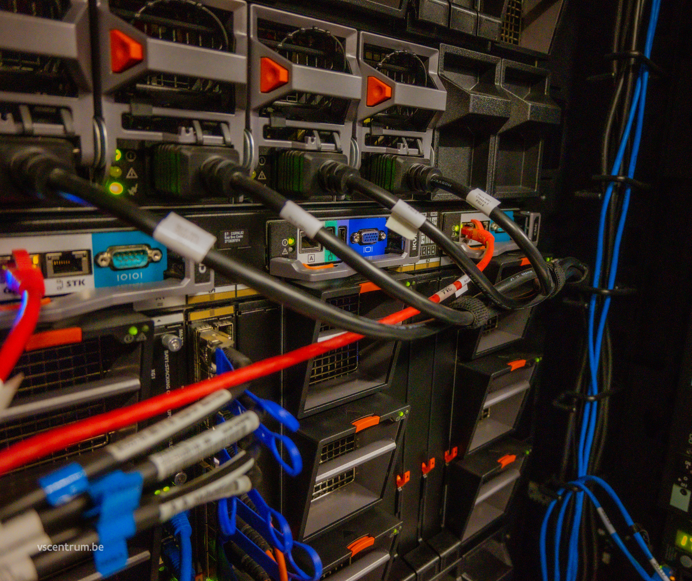
Compute nodes wice
2 Intel Icelake CPUs
36 cores
2.4 GHz
256 GB RAM
960 GB SSD
172 nodes

Slide 6
Compute nodes wice
2 Intel Sapphire Rapids CPUs
48 cores
2.1 GHz – 3.8 GHz (turbo)
256 GB RAM
960 GB SSD
86 nodes

Slide 7
Compute nodes genius
2 Cascadelake CPUs
18 cores
2.6 GHz
192 GB RAM
200 GB SSD
144 nodes

Slide 8
Specialized compute nodes
More memory
5 nodes with 2 TB RAM
1 node with 8 TB RAM
GPU nodes
20 × 4 NVIDIA P100, 16 GB GDDR
2 × 8 NVIDIA V100, 32 GB GDDR
4 × 4 NVIDIA A100, 80 GB GDDR
4 × 4 NVIDIA H100, 80 GB HBM3
Interactive nodes

Slide 9

Network
Low-latency, high-bandwidth
NVIDIA Infiniband HDR-100
12 % – 18 % of budget!
Crucial for HPC appcliations

Slide 10
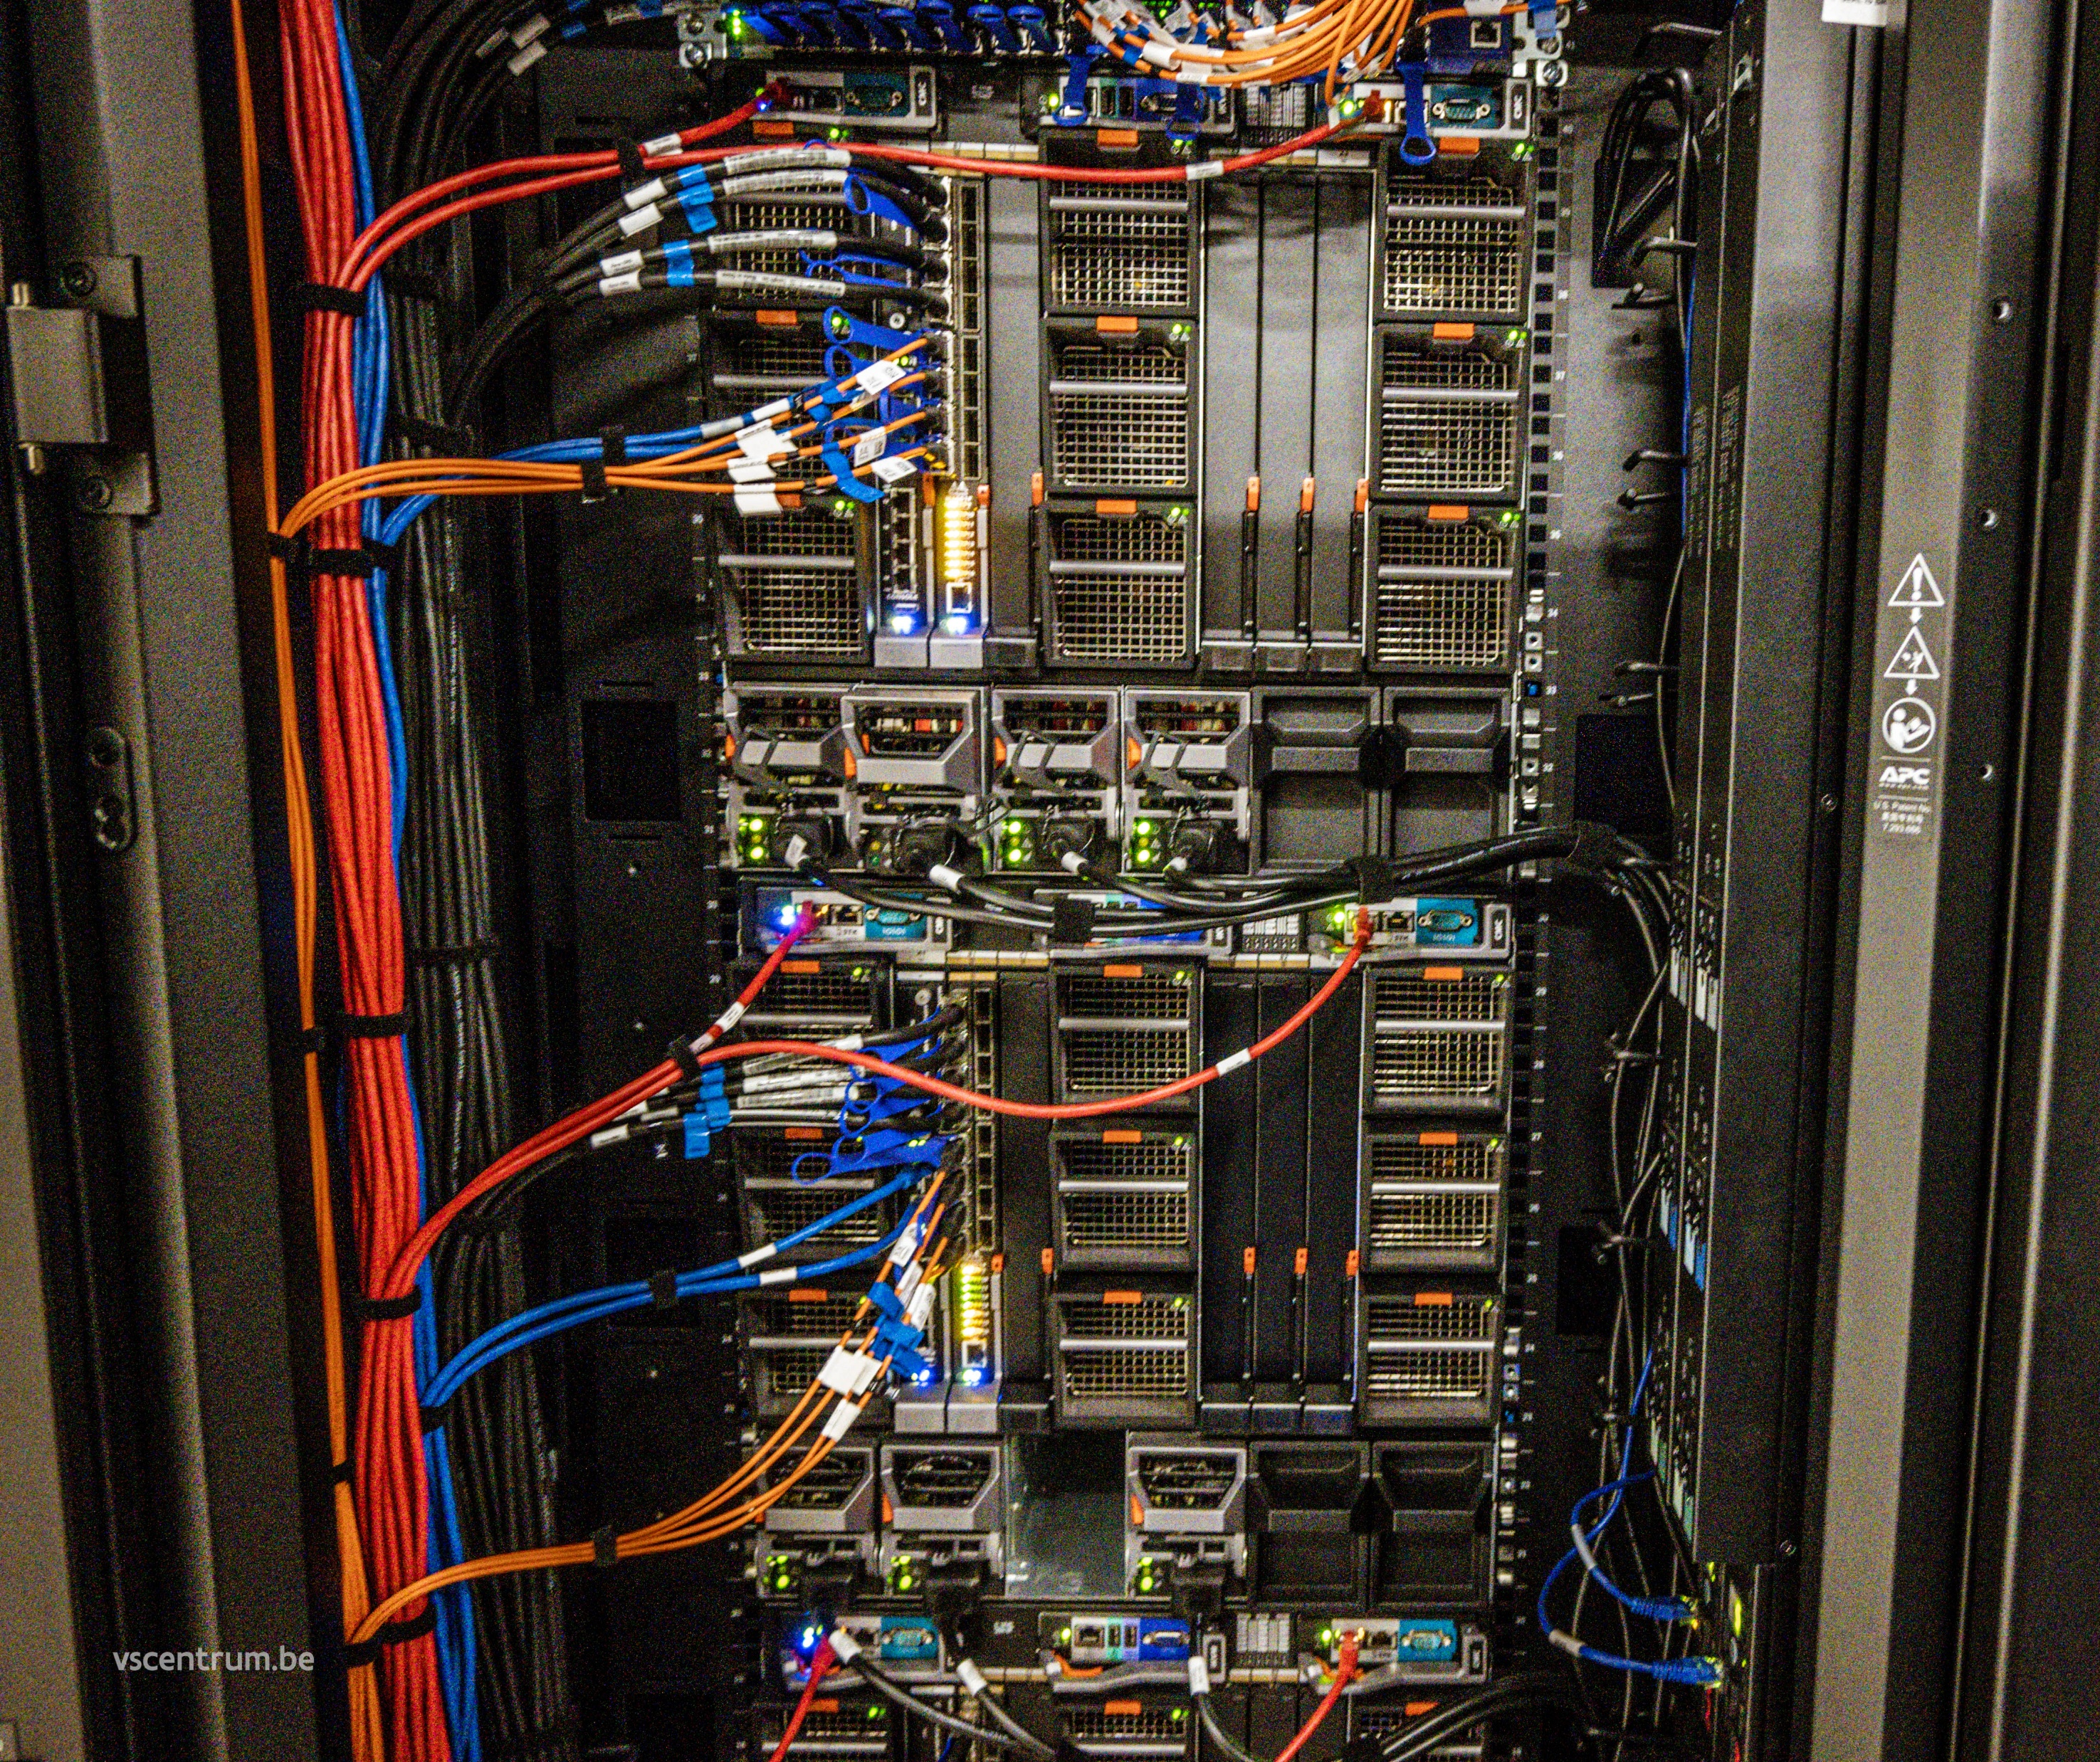

Permanent file storage
$VSC_HOME
3 GB maximum
Configuration files
$VSC_DATA
75 GB maximum
Code & data
VSC_HOME VSC_DATA
Backups & snapshots

Slide 11
Temporary file storage
$VSC_SCRATCH
500 GB standard
Automatically removed when not used for a month
Fast I/O
Parallel I/O
VSC_SCRATCH
No backup!

Slide 12
Other file storage options
$VSC_SCRATCH_NODE
900 GB (wice)
200 GB (genius)
Only available while job runs
Staging
Large active data sets
No backup!

Slide 13
Bird's eye view
VSC_HOME VSC_DATA
VSC_SCRATCH
HPC cluster

Slide 14

Login nodes
4 login nodes
Redundancy
Load balancing
For launching & monitoring jobs
Not for computations!

Slide 15
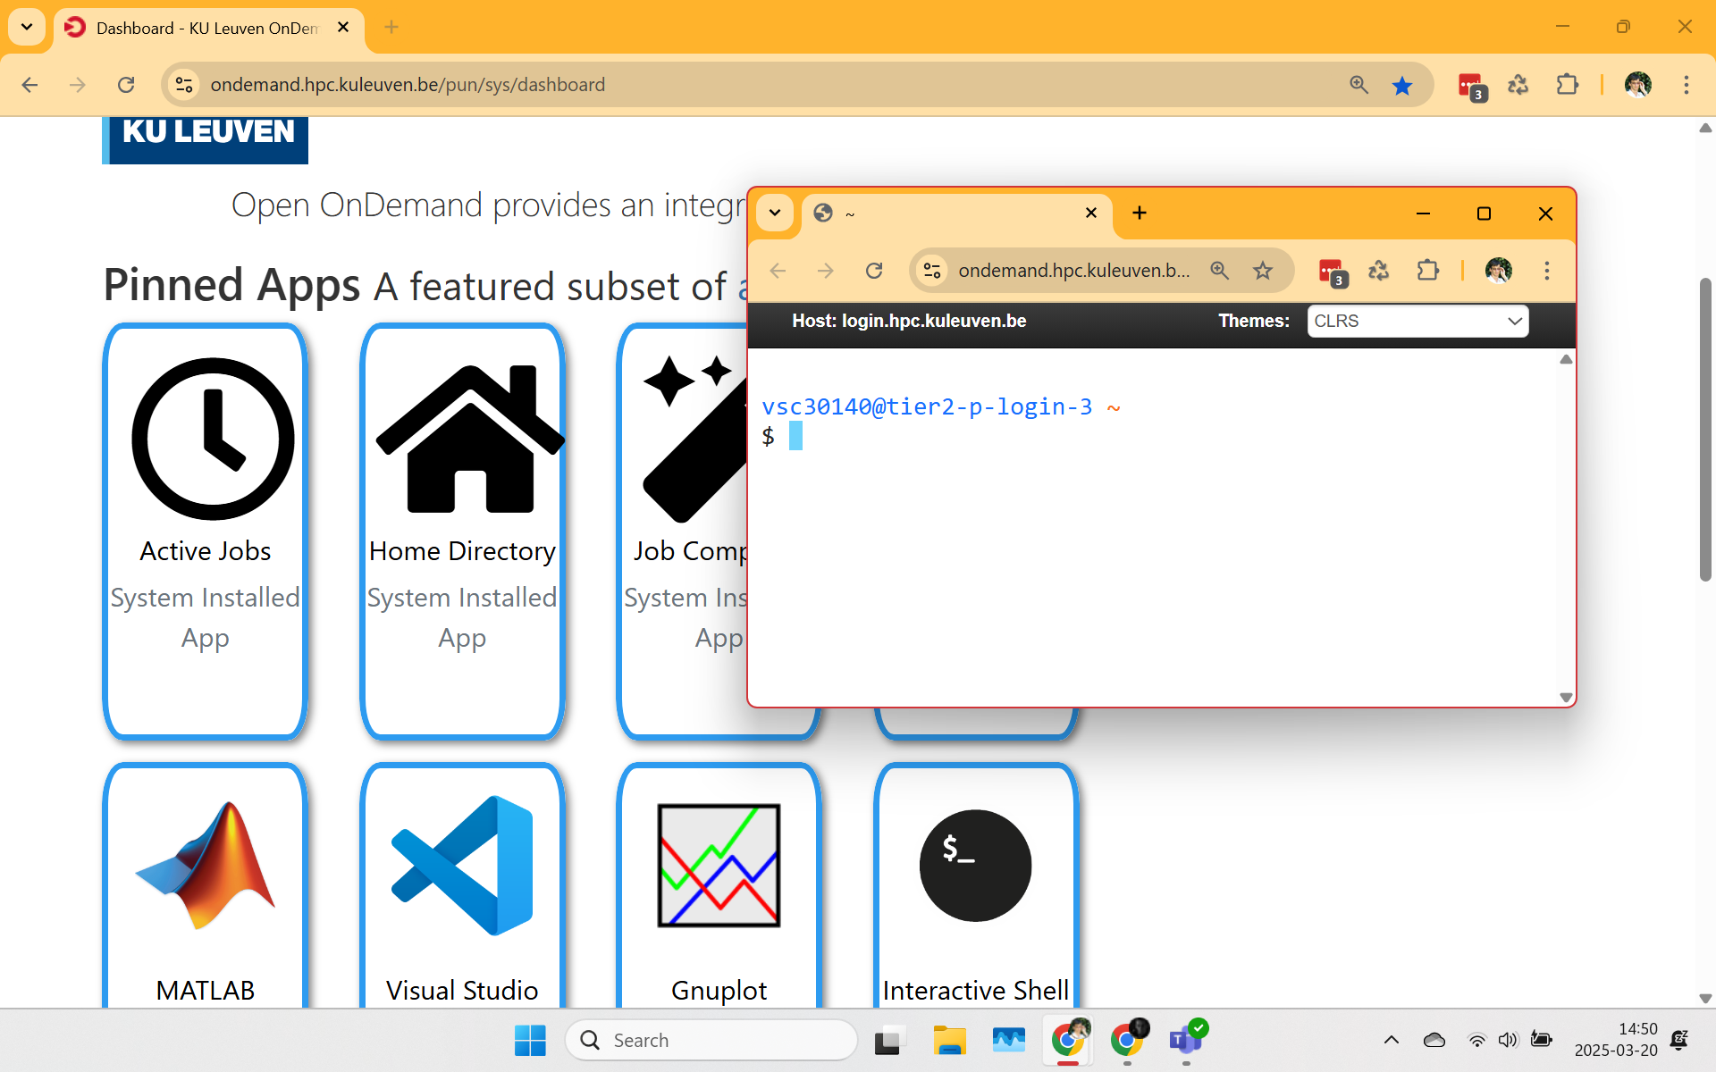
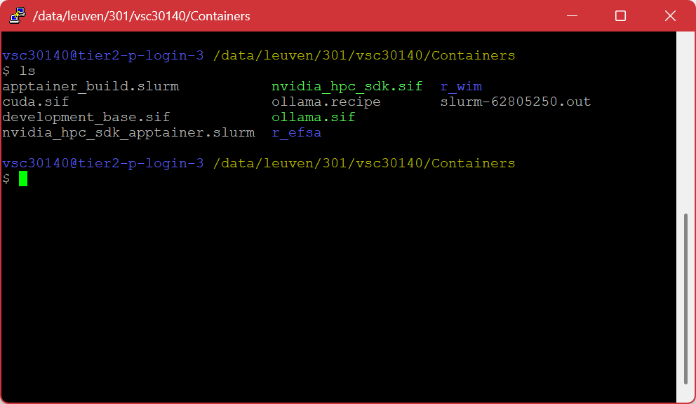
Connection
Using Open OnDemand web portal
Using SSH terminal client
Host: login.hpc.kuleuven.be
https://ondemand.hpc.kuleuven.be

Slide 16


Bird's eye view
VSC_HOME VSC_DATA
VSC_SCRATCH
HPC cluster

Slide 17
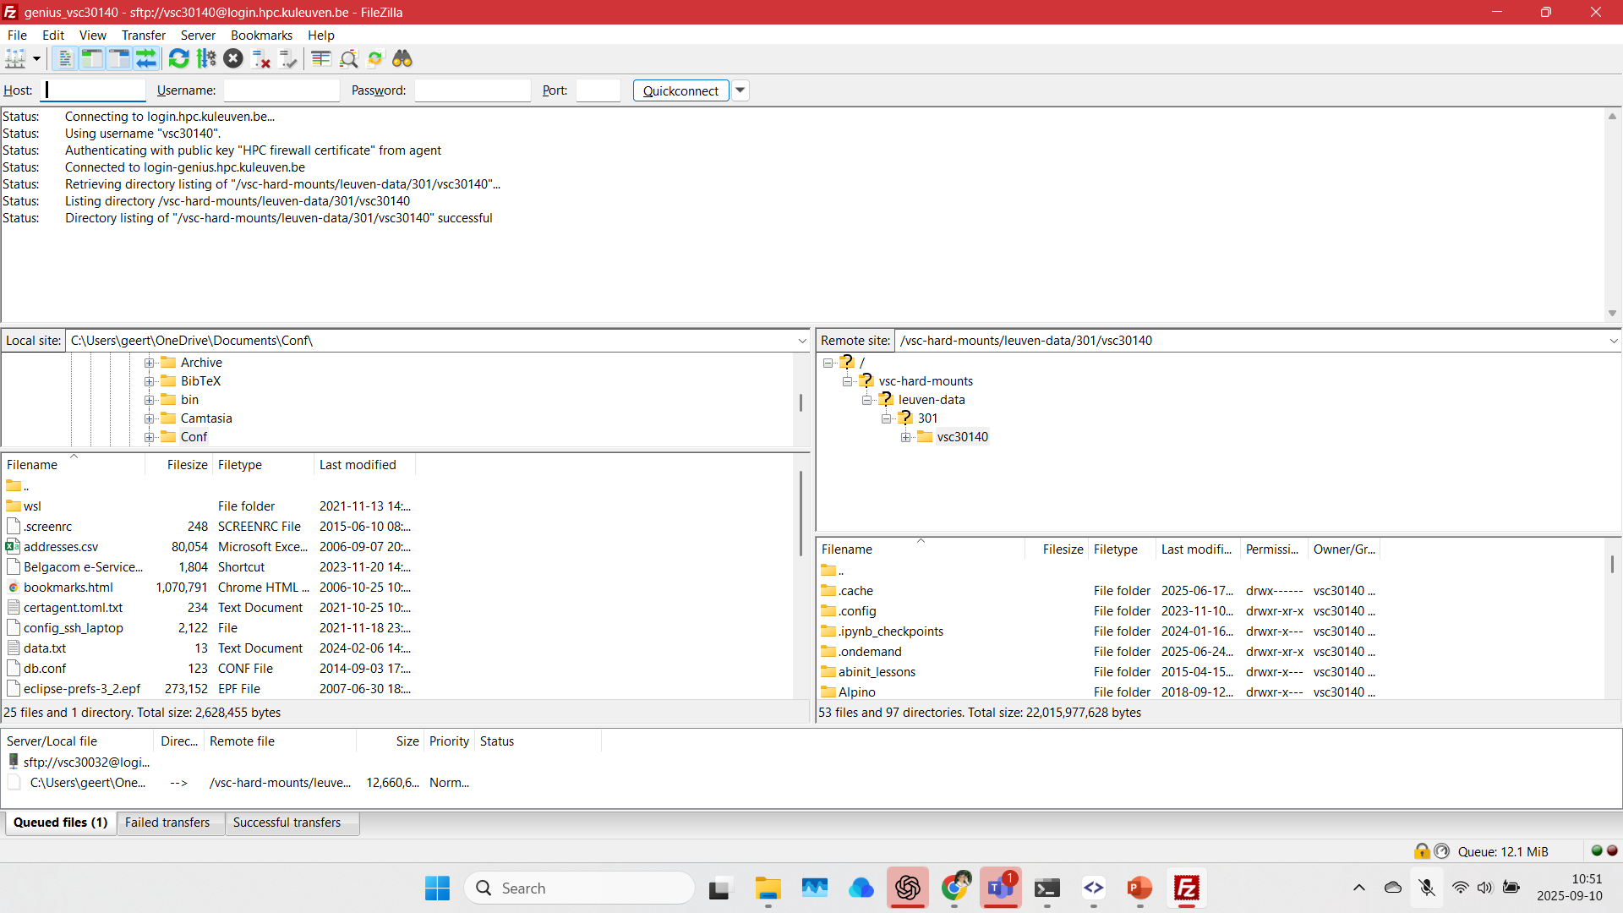
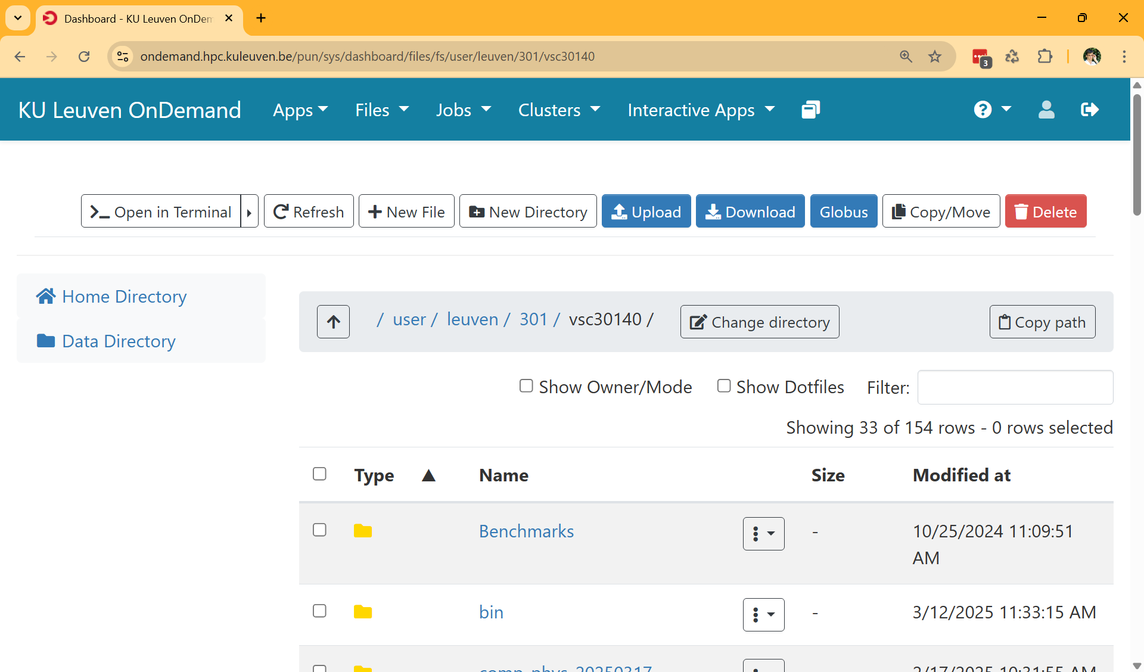
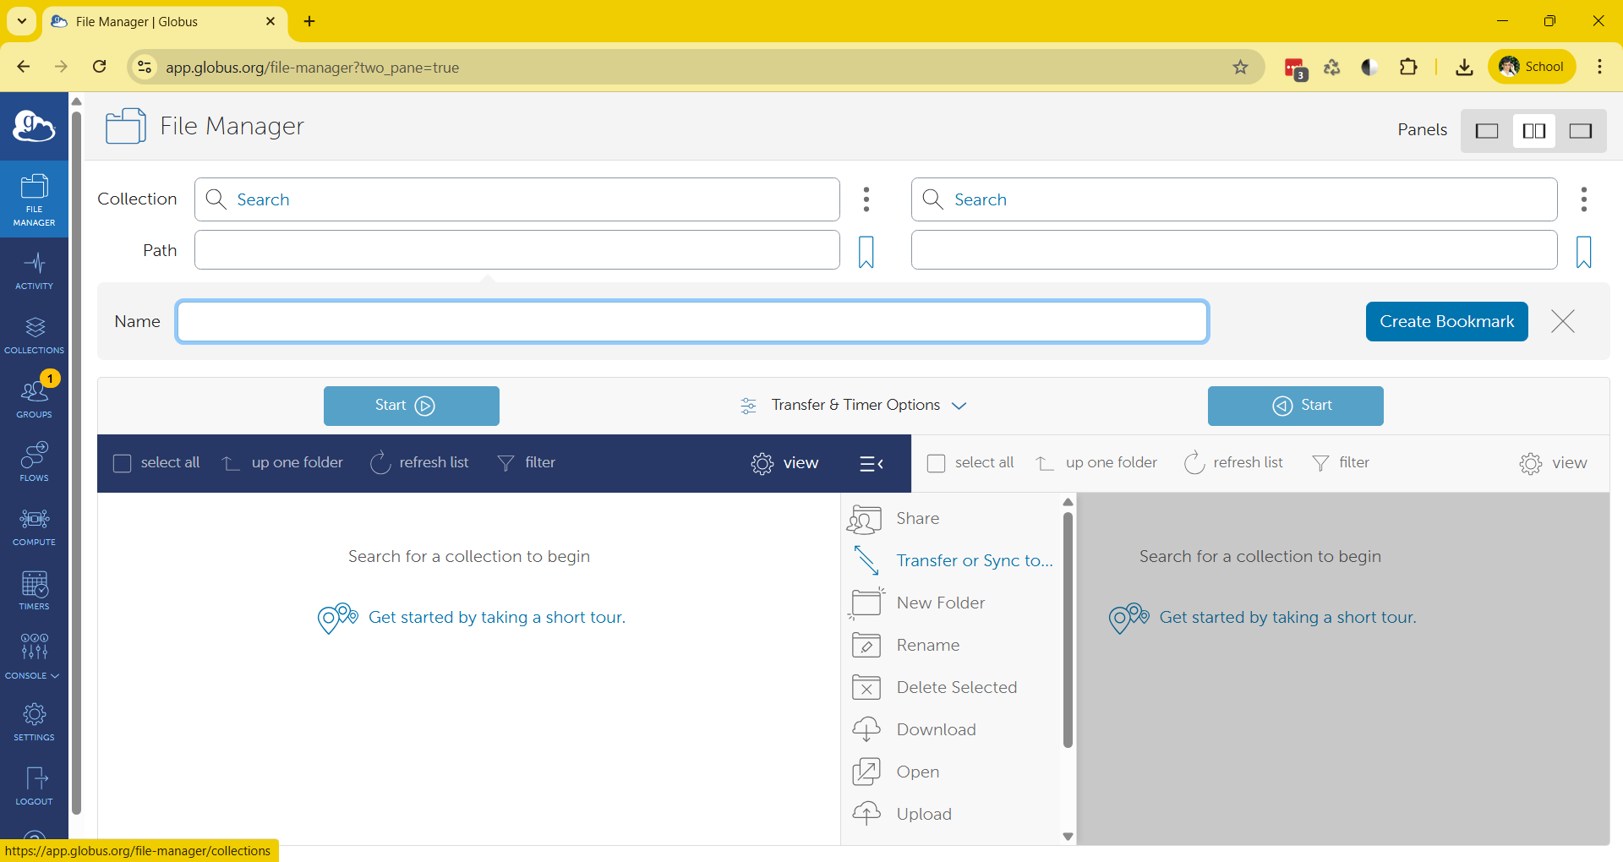
File transfer

Slide 18

Job script
How to execute
Required resources
Commands to run
#!/bin/bash -l
#SBATCH --account=lp_genome_project
#SBATCH --cluster=wice
#SBATCH ---time=00:02:00
echo "my first job!"
job.slurm
job.slurm

Slide 19


Scheduler
Properties of compute nodes
Jobs submitted
Jobs running
Determines when/where to run jobs
Slurm

Slide 20
Bird's eye view
job.slurm
Slurm
VSC_HOME VSC_DATA
VSC_SCRATCH
HPC cluster

Slide 21


Software stack
Many software packages
Many versions of each software package
Must be available for reproducibility
Module system
modules

Slide 22
Job script
How to execute
Required resources
Commands to run
#!/bin/bash -l
#SBATCH --account=lp_genome_project
#SBATCH --cluster=wice
#SBATCH ---time=00:02:00
module load BWA/07.13
bwa mem index_prefix input.fastq ...
job.slurm
job.slurm

Slide 23
Bird's eye view
job.slurm
modules
Slurm
VSC_HOME VSC_DATA
VSC_SCRATCH
HPC cluster

Slide 24
Credits
Credits required to run jobs!
Request project credits
KU Leuven (KU Leuven login required) https://icts.kuleuven.be/sc/HPC
Introduction credits
Project credits, project name p_<what-you-like-and-is-unique>
In job script #SBATCH --account=lp_<what-you-like-and-is-unique>
UHasselt https://admin.kuleuven.be/icts/onderzoek/hpc/request-project-credits
Project credits only, , project name p_h_<what-you-like-and-is-unique>
In job script #SBATCH --account=lp_h_<what-you-like-and-is-unique>

Slide 25

Acknowledgments
Don't forget to acknowledge VSC in publications!
Important for our funding
Helps your exposure
https://docs.vscentrum.be/how_do_i_acknowledge_the_vsc_in_publications.html
Share your success: https://www.vscentrum.be/sys
Put our logo on your poster

Slide 26

Getting help
Check documentation https://docs.vscentrum.be/
Follow training sessions https://www.vscentrum.be/vsctraining
Check status page
https://status.vscentrum.be/
Ask for help
geertjan.bex@uhasselt.be
hpcinfo@kuleuven.be

